Slide 1
Remaining Useful Life Prediction of Turbofan Engines using NASA’s C-MAPSS Dataset
A DEEP LEARNING APPROACH TO PREDICT EQUIPMENT FAILURE BEFORE IT HAPPENS

Slide 2
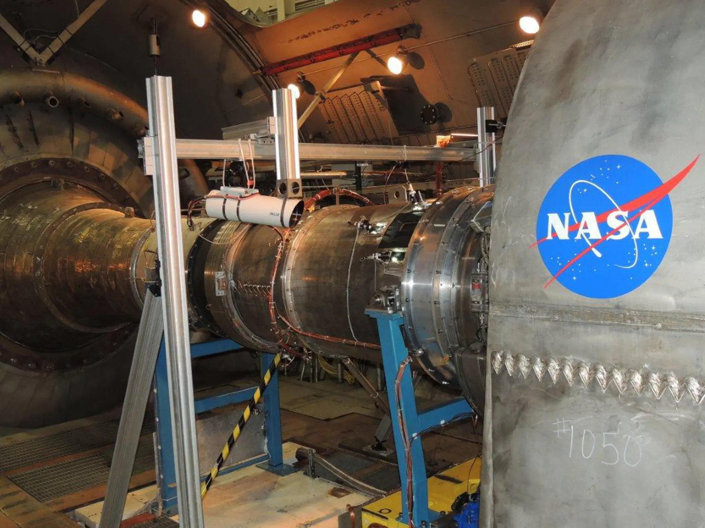
INTRODUCTION TO REMAINING USEFUL LIFE (RUL) PREDICITON:
What is RUL Predicition?
Aircraft engines degrades gradually through operational wear and tear. RUL (Remaining Useful Life) predictions used to estimate time an engine/ component will function before failure occurs.
Why it is important?
Passenger safety risks and potential catastrophic outcomes
Efficient Maintenance - Avoids unplanned downtime by scheduling repairs before failure.
Emergency landings costing $100,000+ per incident
It enables predictive maintenance, reducing unexpected breakdowns and enhancing operational safety.

Slide 3
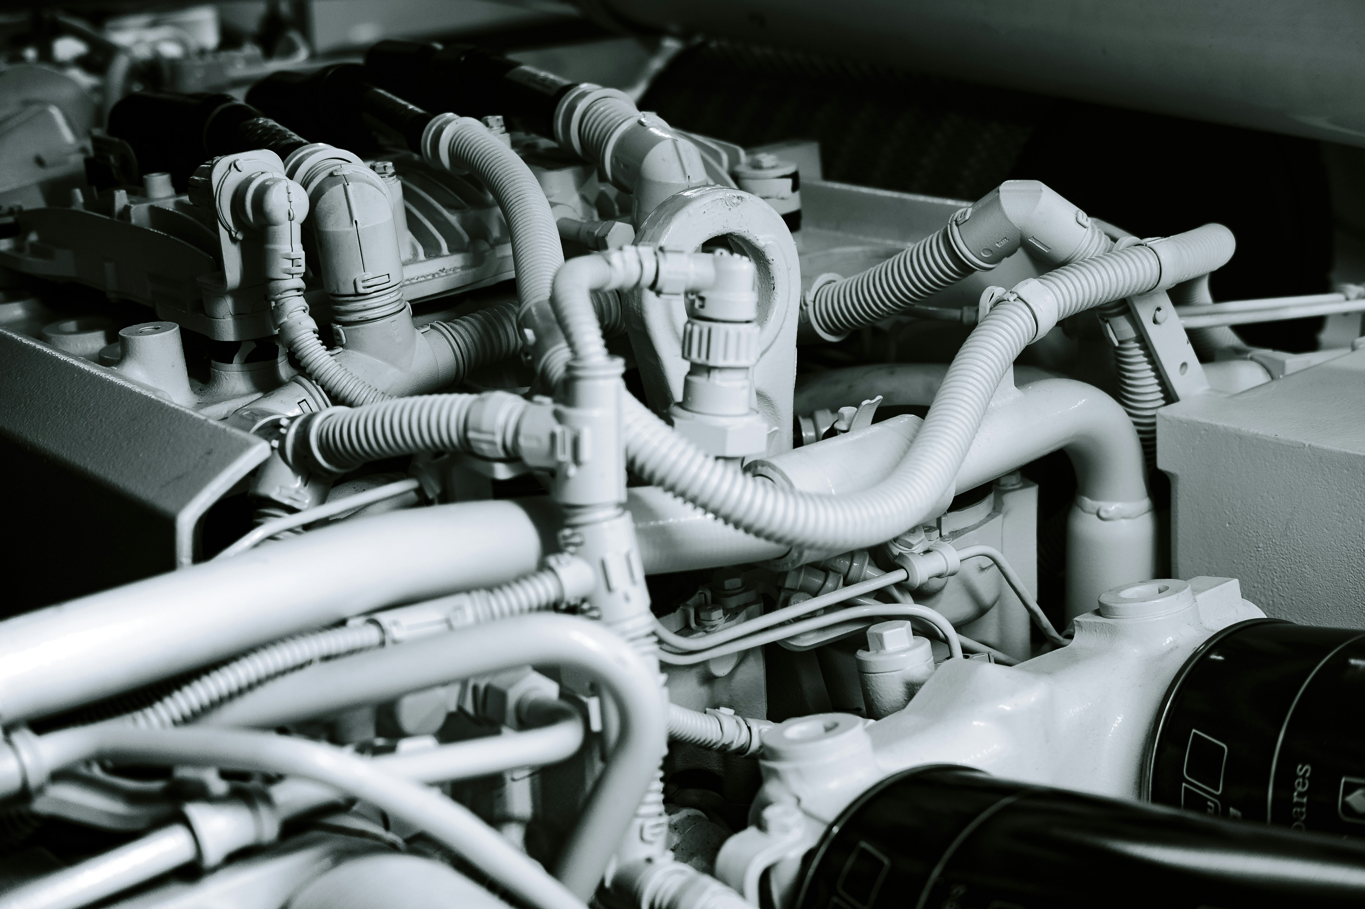
Introduction to Remaining Useful Life (RUL) Prediciton:
The maintenance challenge:
Reactive approach: Wait for failure → Dangerous and costly
Fixed-interval approach: Replace too early → Wastes serviceable components
Predictive approach: Replace at optimal time → The ideal solution
Remaining Useful Life (RUL) Prediction: The Game-Changer:
Precisely forecasts when components will reach end-of-life
Enables condition-based maintenance decisions
Transforms maintenance from guesswork to science
Real-World Impact:
25-30% reduction in maintenance costs
15-20% increase in component lifespan
Near-elimination of unexpected in-service failures
Critical for modern aerospace operations and competitiveness

Slide 4

DATASET INFORMATION
About the Dataset:
CMAPSS (Commercial Modular Aero-Propulsion System Simulation) dataset by NASA contains sensor readings from multiple engines over time.
Engines degrade differently based on operating conditions, making RUL estimation challenging.
Key Feature:
4 sub-datasets: FD001, FD002, FD003, FD004 (Different operating conditions & failure modes).
21 sensor readings per engine: Temperature, pressure, fan speed, etc.
Each engine has a different RUL based on degradation trends.

Slide 5
NASA’s CMAPSS DATASET:
Feature Type | # of Features | Description
Engine ID | 1 | Unique identifier for each engine
Cycle | 1 | Time cycle for the engine
Operational Settings | 3 | Varying operational conditions
Sensor Readings | 21 | Health- related engine parameters
Total Features | 26 | Combination of the above
Dataset | # of Engines | # of Data Points (Train) | # of Data Points (Test) | Operating Conditions | Failure Modes
FD001 | 100 | 20,631 | 13,096 | 1 | 1
FD002 | 260 | 53,759 | 39,161 | 6 | 1
FD003 | 100 | 24,815 | 16,066 | 1 | 2
FD004 | 249 | 61,229 | 42,104 | 6 | 2
Table no.1 Summary Table of CMAPSS Dataset
Table no.2 Summary Table of subset FD001 Dataset

Slide 6
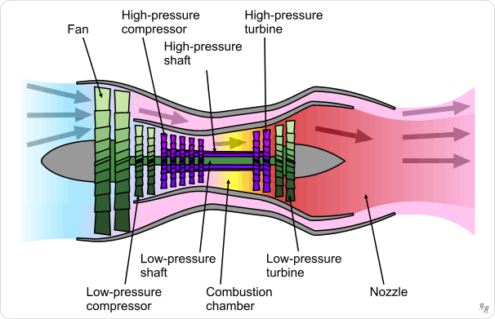
Working of Turbofan Engine:
Component | Function
Fan | Pulls in large amounts of air
Low-Pressure Compressor | Slightly compresses the incoming air.
High-Pressor Compressor | Further compresses air to make it denser.
Combustion Chamber | Mixes fuel with compressed air & ignites it.
High-PressureTurbine | Extracts energy from hot gases to drive the compressor.
Low-Pressure Turbine | Extracts extra energy to spin the fan.
Nozzle | Expels hot gases at high speed for thrust.
Figure no.1 - Illustration of Turbofan Engine
Air goes in → gets squeezed → fire explosion → turbines spin → plane moves forward!
Table no.3 - Summary table of Components & Functions

Slide 7
NASA’s CMAPSS DATASET:
Table no.4 - Summary table of 21 sensors
Sensor Name | Type of Measurement | Description
Sensor_1 | Temperature Sensor | Measures engine temperature at a specific location
Sensor_2 | Pressure Sensor | Detects air pressure within the engine system
Sensor_3 | Temperature Sensor | Monitors exhaust gas temperature (EGT)
Sensor_4 | Vibration Sensor | Captures mechanical vibrations in the engine
Sensor_5 | Fuel Flow Sensor | Measures fuel consumption rate
Sensor_6 | Airflow Sensor | Detects air intake into the engine
Sensor_7 | Speed Sensor | Monitors the speed of a rotating component
Sensor_8 | Pressure Sensor | Measures oil or hydraulic system pressure
Sensor_9 | Temperature Sensor | Checks lubricant or cooling system temperature
Sensor_10 | Torque Sensor | Measures Torque applied in the engine shaft
Sensor_11 | Humidity Sensor | Detects moisture levels in the air intake
Sensor_12 | Acoustic Sensor | Monitors engine noise and sound wave anomalies
Sensor_13 | Flow Rate Sensor | Measures coolant or lubricant flow rate
Sensor_14 | Current Sensor | Detects electrical current in critical components
Sensor_15 | Voltage Sensor | Monitors voltage fluctuations in engine circuits
Sensor_16 | Acceleration Sensor | Captures sudden changes in movement
Sensor_17 | Exhaust Gas Sensor | Measures gas composition from exhaust
Sensor_18 | Combustion Sensor | Monitors combustion efficiency in the chamber
Sensor_19 | Oil Quality Sensor | Detects contamination in engine oil
Sensor_20 | Bearing Wear Sensor | Monitors wear and tear of rotating parts
Sensor_21 | Structural Stress Sensor | Measures mechanical stress on engine components

Slide 8
Approach:
Feature Extraction
Data Splitting
Data Loading
Data Cleaning
Train data
Test data
> Random Forest
>XGBoost
>LSTM
>Mean Squared Error
>Hyperparameter Tunning
Model Building
RUL Prediction
Model Evaluation
Model Training

Slide 9

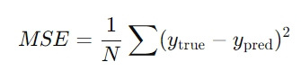
Model Training & Evaluation:
Loss Function: Mean Squared Error (MSE)
MSE is used because we are dealing with regression (continuous value prediction).
Formula:
Why not MAE (Mean Absolute Error)?
MSE penalizes large errors more, ensuring the model learns to make precise predictions.
Hyperparameter Tunning:
To improve LSTM performance, Keras Tuner is used:
Number of LSTM units: 50, 100, 200
Batch size: 32, 64
Learning rate: 0.001, 0.0001
Dropout rate: 0.2, 0.3

Slide 10
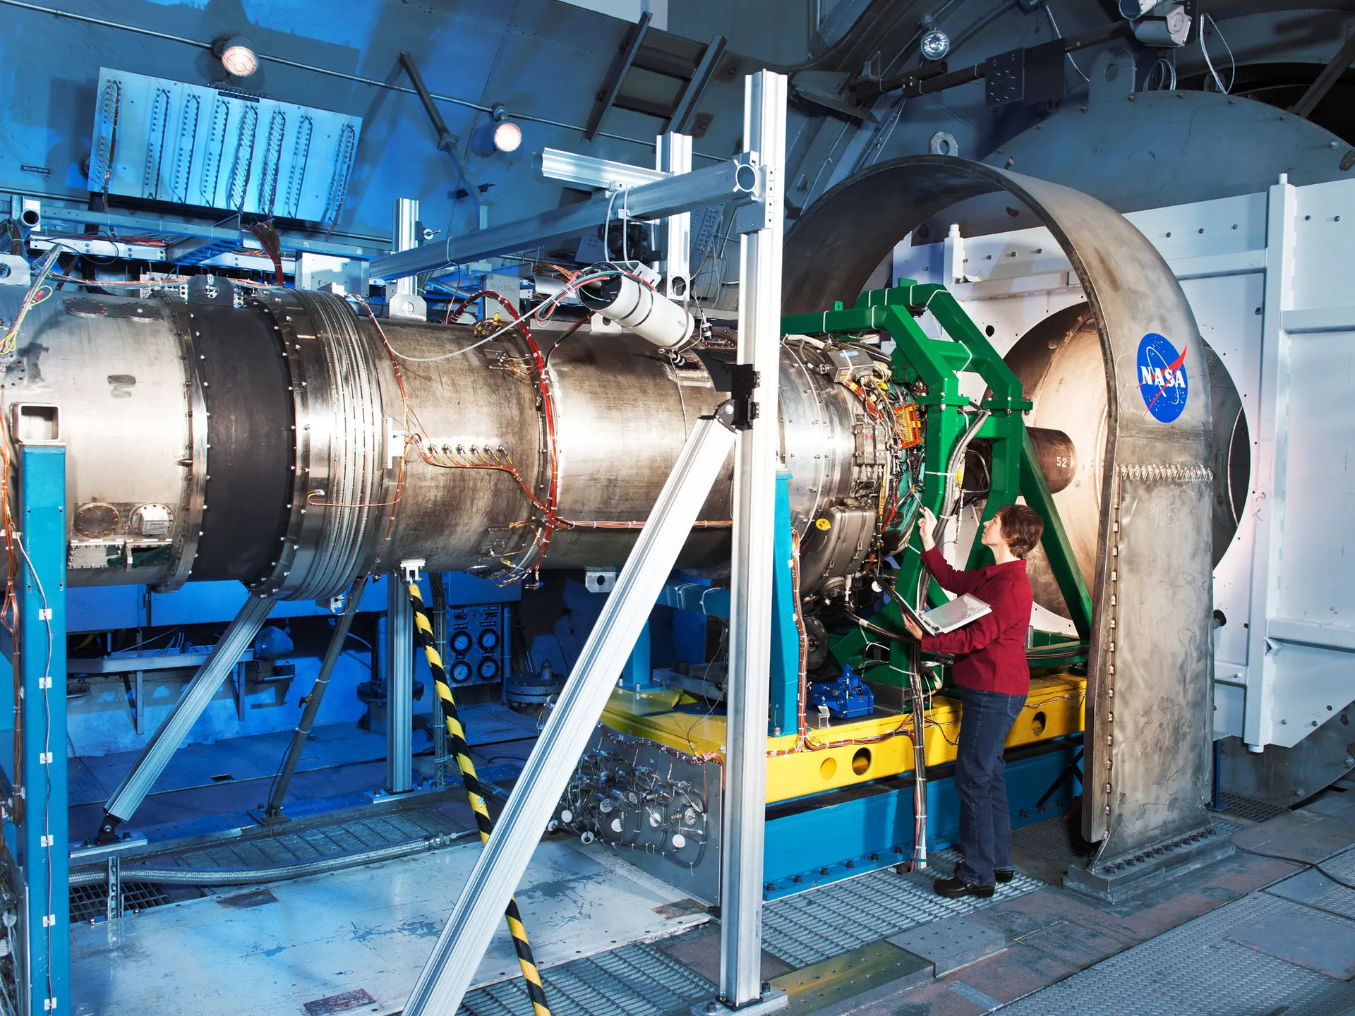
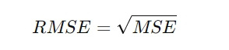
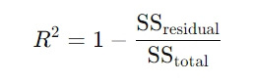
Model Evaluation:
We evaluate model accuracy using:
Root Mean Squared Error (RMSE):
Why RMSE?
Easier to interpret since it's in the same unit as RUL.
R² Score (Coefficient of Determination)
It measures how well the model fits the data.

Slide 11
Results:
Comparing Models:
Model | RMSE | R² Score
Random Forest | 30.2 | 0.75
XGBoost | 25.8 | 0.80
LSTM | 14.5 | 0.90
Table no.5- Results of different Models

Slide 12
CHALLENGES
01
02
03
04
HIGH-DIMENSIONAL SENSOR DATA
ENGINE-SPECIFIC PATTERNS
MODEL GENERALIZATION
DEPLOYMENT
Managing 21+ sensor readings per engine.
Selecting the most relevant features for accurate predictions.
Each engine degrades differently due to wear and operating conditions.
Hard to capture unique degradation trends in a single model.
Ensuring the model works across diverse engines & environments.
Preventing overfitting to specific failure patterns.
Handling real-time data processing in aircraft systems.
Making the model efficient, interpretable, and scalable.

Slide 13
THANK YOU

